Slide 1
CS8611-MINI PROJECT
In partial fulfillment for the award of the degree
Of
BACHELOR OF ENGINEERING
IN
COMPUTER SCIENCE AND ENGINEERING
submitted by
D. JAYAKUMAR
G. NITHISH KUMAR

Slide 2
TITLE OF THE PROJECT
ABSTRACT
INTRODUCTION
HARDWARE & SOFTWARE
TOOLS & TECHNOLOGIES
IMPORTANCE
CHALLENGES
TABLE OF
CONTENT

Slide 3
OUTPUT PREVIEW
PROGRAM EXPLANATION
SAMPLE OUTPUT
CONCLUSION
FUTURE SCOPE
TABLE OF
CONTENT

Slide 4
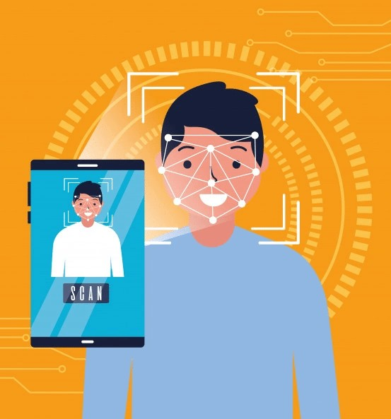
FACE RECOGNITION BASED ATTENDANCE SYSTEM
TITLE OF THE PROJECT
To maintain attendance by using facial recognition technology

Slide 5







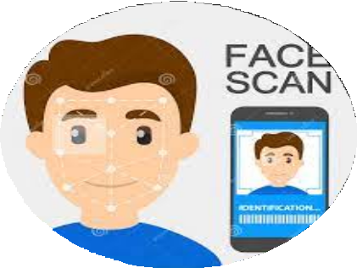
CAMERA
ATTENDANCE
STUDENT
DETECTION

Slide 6

ABSTRACT
The main purpose of this project is to build a face recognition-based attendance monitoring system for educational institution to enhance and upgrade the current attendance system into more efficient and effective as compared to before. The current old system has a lot of ambiguity that caused inaccurate and inefficient of attendance taking. Many problems arise when the authority is unable to enforce the regulation that exist in the old system. The technology working behind will be the face recognition system. The human face is one of the natural traits that can uniquely identify an individual. Therefore, it is used to trace identity as the possibilities for a face to deviate or being duplicated is low. In this project, face databases will be created to pump data into the recognizer algorithm. Then, during the attendance taking session, faces will be compared against the database to seek for identity. When an individual is identified, its attendance will be taken down automatically saving necessary information into a excel sheet. At the end of the day, the excel sheet containing attendance information regarding all individuals are mailed to the respective faculty.

Slide 7
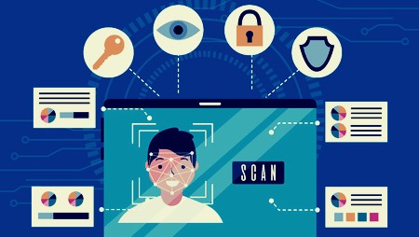
INTRODUCTION
Every college require an attendance system to maintain record of present student.
Face Recognition Attendance System is developed for the Faculty to maintain attendance record.
It uses facial recognition technology to identify the person’s facial features and automatically mark attendance which is very fast enough than previous method.

Slide 8










SOFTWARE
HARDWARE
Computer (i3, 4gb)
Windows 10
Camera
Python
Hard Disk:- 1TB
Visual Studio Code

Slide 9

TOOLS & TECHNOLOGIES USED
1. PYTHON
Python is a high-level, interpreted, and general-purpose dynamic programming language that focuses on code readability.
It generally has small programs when compared to Java and C.
It was founded in 1991 by developer Guido Van Rossum.
Python ranks among the most popular and fastest-growing languages in the world.
Python is a powerful, flexible, and easy-to-use language.
In addition, the python community is very active.
It is used in many organizations as it supports multiple programming paradigms.
It also performs automatic memory management.

Slide 10
TOOLS & TECHNOLOGIES USED
WHY WE USE PYTHON?
Free and open-source
Simple and Easy to learn
Portable and Extensible
Object-Oriented Programming
Availability of support
Large global community
Extensive libraries
Powerful frameworks

Slide 11

TOOLS & TECHNOLOGIES USED
2. OPENCV
OpenCV is a huge open-source library for computer vision, machine learning, and image processing.
OpenCV supports a wide variety of programming languages like Python, C++, Java, etc.
It can process images and videos to identify objects, faces, or even the handwriting of a human.
When it is integrated with various libraries, such as Numpy which is a highly optimized library for numerical operations, then the number of weapons increases in your Arsenal
whatever operations one can do in Numpy can be combined with OpenCV.

Slide 12
TOOLS & TECHNOLOGIES USED
3. FACE DETECTION
4. FACE RECOGNITION
Face detection is the ability to identify the person’s faces within the digital images.
This system identifies the human face present in an image or video.
Human faces have the same features such as eyes, nose, forehead, mouth, and chin.
Therefore, the objective of face detection is to find the location and size of the face in an image.
The located face is then used by the facial recognition algorithm.
Face Recognition is being able to uniquely identify and verify a person’s face by comparing and analyzing a biometrics person’s face.
A face recognition system is an application that is used for identifying or verifying a person from a digital image.

Slide 13
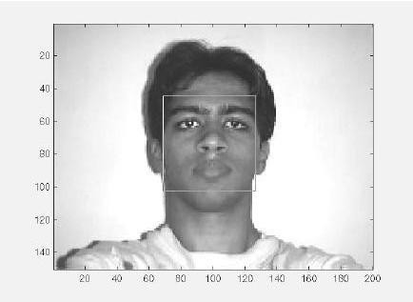
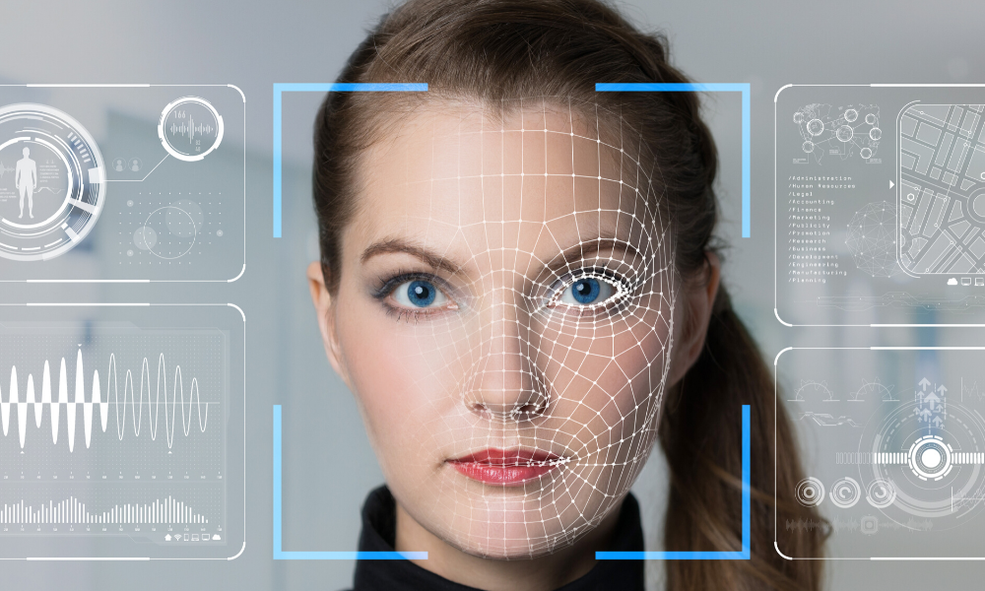
TOOLS & TECHNOLOGIES USED
3. FACE DETECTION
4. FACE RECOGNITION

Slide 14
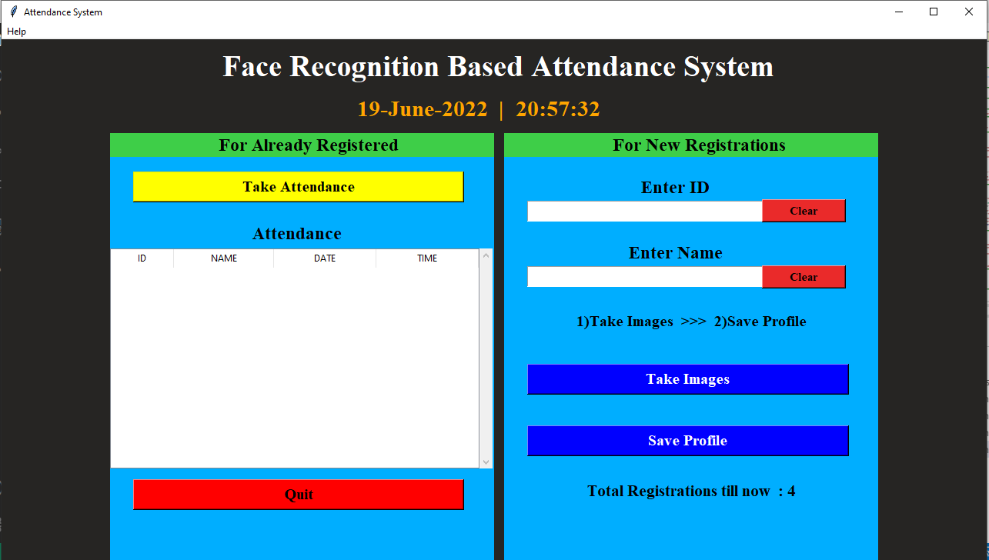
OUTPUT PREVIEW
User
Interface

Slide 15
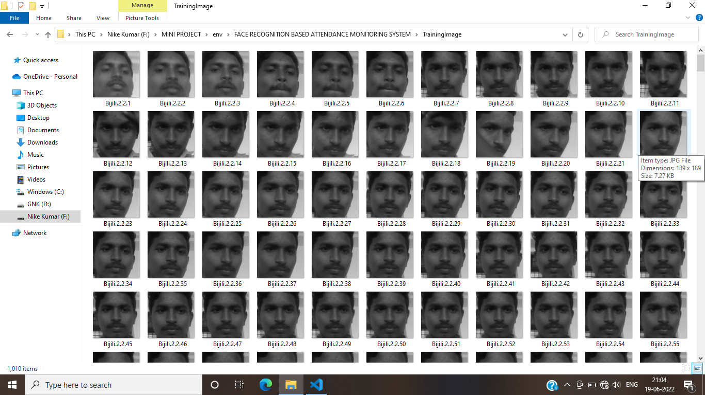

OUTPUT PREVIEW
Training images
Student Details

Slide 16
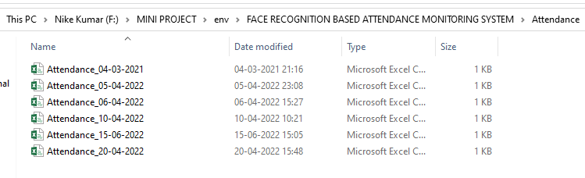
OUTPUT PREVIEW
Attendance Details

Slide 17
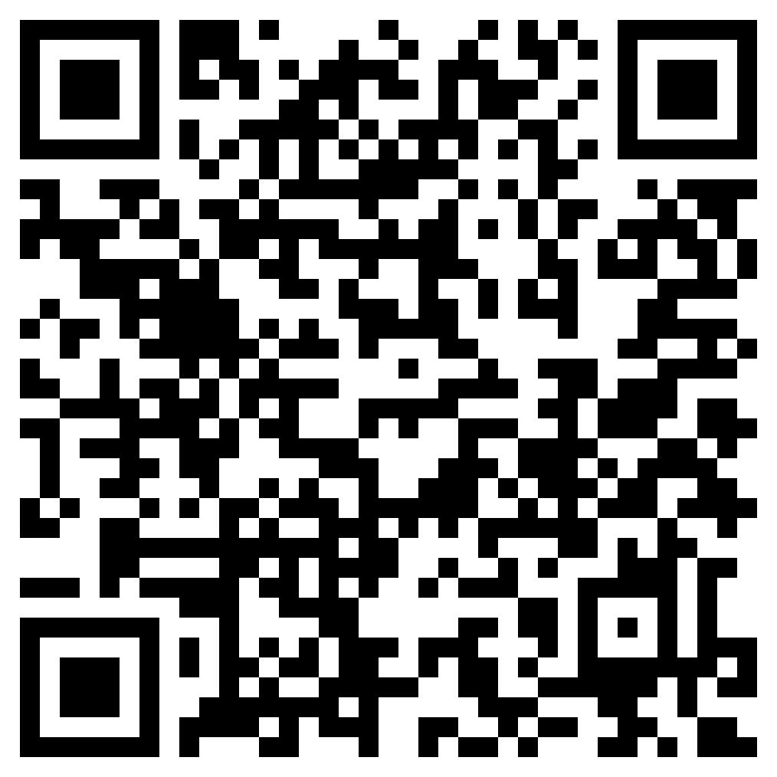
PROGRAM SOURCE CODE
TO DOWNLOAD :
https://drive.google.com/file/d/1936igAgK_zN6KrrC1dOMeaPoBWLLhDv_/view?usp=sharing

Slide 18
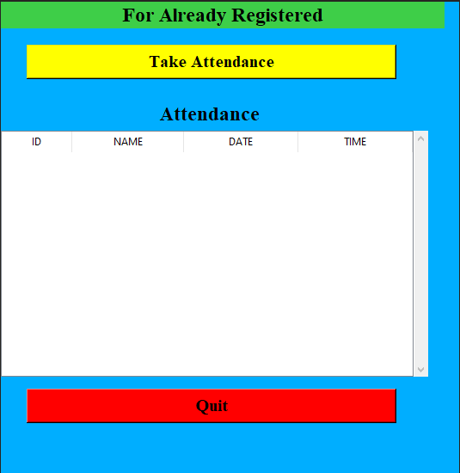
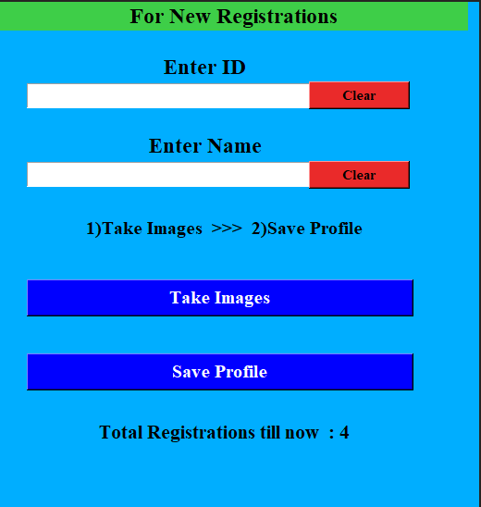
SAMPLE OUTPUT

Slide 19


CONCLUSION
Before the development of this project. There are many loopholes in the previous method while taking attendance using old method which caused many troubles to most of the institutions.
Therefore, the facial recognition feature method is secure enough, reliable and available for use. It saves time and lot of effort, especially if it is a lecture with huge number of students

Slide 20


FUTURE SCOPE
Some of the future enhancements that can be done to this system are as follows:
Facility of Defaulter list in which system update the defaulter student.
For students, we can develop a dedicated login page in which they can see their details and attendance record
In future we can update the modules like notices for student and many more.

Slide 21

Thank You!

